Slide 1
FEATURES OF ANGULAR 7

Slide 2
CONTENTS
Features of angular 7
Animation
Material
guards

Slide 3
Features:
CLI Prompts. In angular 7, the command line interface (CLI)
Application Performance
Virtual Scrolling
Drag and Drop
Bundle Budget
Angular Compiler
Angular Elements
Angular Do-Bootstrap

Slide 4
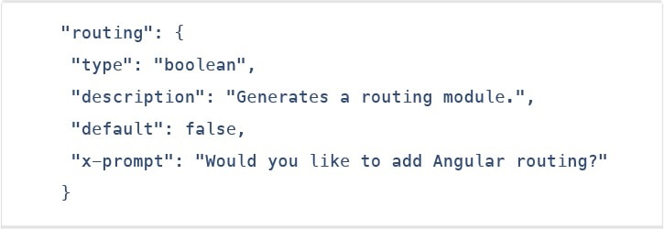
CLI Prompts
In Angular 7, the CLI prompts have been updated to v7.0.2 with new features. For instance, it will now prompt users when typing commands like @angular/material, ng-new, and ng-add to help them discover the in-built SCSS support, routing, and more.
These CLI prompts, in addition, have been added to Schematics, so that all package publishing schematics can now benefit from CLI prompts.

Slide 5
Application Performance:
Angular 7 is faster as compared to the previous versions of angular. Certain new features introduced as discussed above makes the app run faster and perform better. It does not only focus on making framework small but makes the app small too as much as possible. In version 7 the reflect-metadata polyfill (includes in production) remove automatically.
Virtual Scrolling:
Scrolling feature was present in the previous version of angular (angular 6). Angular 7 comes with virtual scrolling. Virtual scrolling allows users to bind a list of elements even its too long in small packets. As per the scroll movements, data will be supplied into packets at the user end. This is one of the Angular 7 features, which is beneficial for mobile apps where scrolling can affect performance. But useful for web applications too as even in web applications if we scroll a long list of data, performance gets affected.

Slide 6
Bundle Budget:
While developing applications on Angular 7, now the developers can set up a budget limit of their bundle size. a default setting of the bundled budget has 2 MB as the lower limit and 5 MB as the higher limit. When the initial bundle is more than 2MB, a new application will warn and will error at 5 MB. The developer can also change these settings as per need. Reduction in bundle size improves the performance of the application.
Angular Compiler:
The new angular compiler offers an 8-phase rotating ahead-of-time compilation. The NGCC (Angular Compatibility Compiler) will convert node_modules compiled with Angular Compatibility Compiler (NGCC), into node_modules which appear to have been composed with TSC compiler transformer (NTSC). Also, Ivy rendering engine can use such “legacy” package due to this compiler change

Slide 7
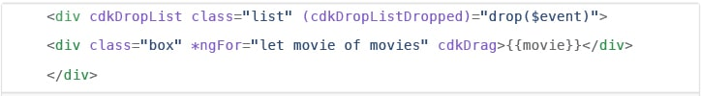
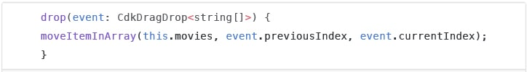
Drag & drop
The new drag-drop module basically provides a better way to easily create drag & drop interfaces, which is backed by sorting within a list, support for free dragging, animations, custom drag handles, transferring items between lists, previews, and placeholders.
In simple terms, the Drag-and-Drop support has now been implemented in CDK and it also includes automatic rendering as the users relocates items.

Slide 8
ANIMATIONS
Animation provides the illusion of motion: HTML elements change styling over time. Well-designed animations can make your application more fun and easier to use, but they aren't just cosmetic. Animations can improve your app and user experience in a number of ways:
Without animations, web page transitions can seem abrupt and jarring.
Motion greatly enhances the user experience, so animations give users a chance to detect the application's response to their actions

Slide 9
Getting started With Animations
The main Angular modules for animations are @angular/animations and @angular/platform-browser. When you create a new project using the CLI, these dependencies are automatically added to your project.
There are three steps involved in aminations.
Step 1: Enabling the animations module
Step 2: Importing animation functions into component files
Step 3: Adding the animation metadata property

Slide 10
Step 1: Enabling the animations module
src/app/app.module.ts
import { NgModule } from '@angular/core’;
import { BrowserModule } from '@angular/platform-browser’;
import { BrowserAnimationsModule } from '@angular/platform- browser/animations’;
@NgModule({
imports: [
BrowserModule,
BrowserAnimationsModule
],
declarations: [ ],
bootstrap: [ ]
})
export class AppModule { }

Slide 11
Step 2: Importing animation functions into component files
src/app/app.component.ts
import { Component, HostBinding } from '@angular/core’;
import {
trigger,
state,
style,
animate,
transition,
// ...
} from '@angular/animations';

Slide 12
Step 3: Adding the animation metadata property
You put the trigger that defines an animation within the animations metadata property.
src/app/app.component.ts
@Component({
selector: 'app-root’,
templateUrl: 'app.component.html’,
styleUrls: ['app.component.css’],
animations: [
// animation triggers go here
]
})

Slide 13
Material:
Materials offer a lot of built-in modules for your project. Features such as autocomplete, datepicker, slider, menus, grids, and toolbar are available for use with materials in Angular 7.
To use materials, we need to import the package. Angular 2 also has all the above features but they are available as part of the @angular/core module. From Angular 4, Materials module has been made available with a separate module @angular/materials. This helps the user to import only the required materials in their project.
Following is the command to add materials to your project −
npm install –save @angular/material

Slide 14
To add menu, <mat-menu></mat-menu> is used. The file and Save As items are added to the button under mat-menu. There is a main button added Menu. The reference of the same is given the <mat-menu> by using [matMenuTriggerFor]="menu" and using the menu with # in<mat-menu>.

Slide 15
guards
CanActivate
CanActivateChild
CanDeactivate
Resolve
CanLoad

Slide 16
CanActivate: Checks to see if a user can visit a route.
CanActivate: ChildChecks to see if a user can visit a routes children.
CanDeactivate: Checks to see if a user can exit a route.
Resolve: Performs route data retrieval before route activation.
CanLoad: Checks to see if a user can route to a module that lazy loaded.

Slide 17
THANK YOU

